Slide 1
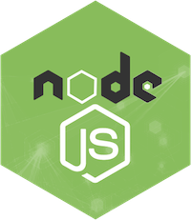
EXPRESS JS

Slide 2
NEED OF EXPRESS JS
Node.js is a Java Script run-time environment that is fast, but it does not support request handling, HTTP methods or serving files, so this is where Express JS comes into the picture.

Slide 3
WHAT IS EXPRESS.JS
Express is a node js web application framework that provides broad features for building web and cross-platform mobile applications.
It is used to build a single page, multipage, and hybrid web application.
Express is high performance , fast, assertive, essential, robust,and lightweight.
Express is used as Server-Side Scripting
we can assume express as a layer built on the top of the Node.js that helps manage a server and routes.

Slide 4
WHY EXPRESS JS?
Express was created to make APIs and web applications with ease,
It saves a lot of coding time almost by half and still makes web and
mobile applications are efficient.
Another reason for using express is that it is written in javascript as javascript is an easy language even if you don't have a previous
knowledge of any language. Express lets so many new developers enter the field of web development.
The reason behind creating an express framework for node js is:
1. Time-efficient 2. Fast 3.Economical
4. Easy to learn 5.Asynchronous

Slide 5
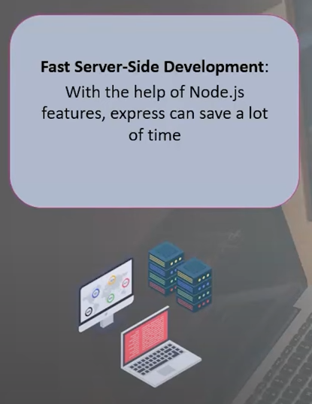
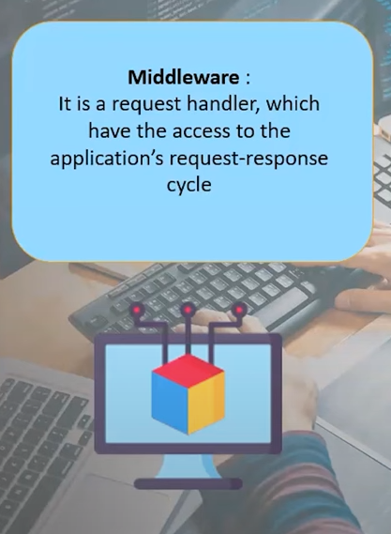
FEATURES OF EXPRESS JS

Slide 6
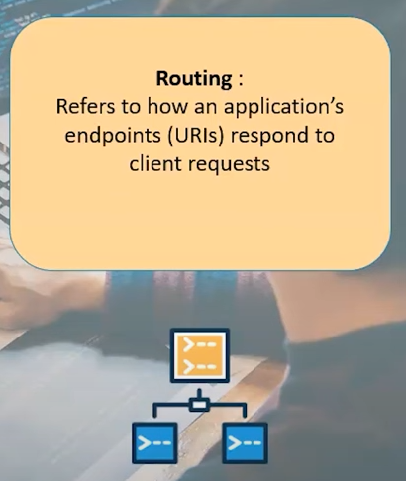
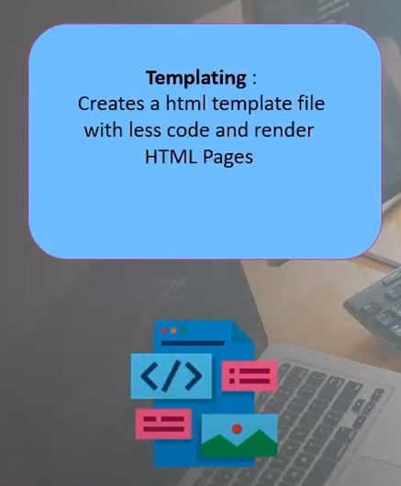
FEATURES OF EXPRESS JS

Slide 7

FEATURES OF EXPRESS JS

Slide 8
ADVANTAGES & DISADVANTAGES OF EXPRESS JS
Advantages :
  Express is very easy we can customize and use it as per our need.
  A single language Javascript is used for front-end and back-end development.
  It is very fast to link with databases like mySQL, MongoDB etc.
Disadvantages:
  No structural way to organize the things
  There are so many issues in callback
  The error messages are not very helpful

Slide 9
INSTALL EXPRESS.JS
Step-1:Use the following command to install express framework globally.
Syntax:
C:\users> npm install -g express
Step-2: Installing Express
Use the following command to install express:
Syntax:
C:\users> npm install express --save

Slide 10
We should install some other important modules along with express. Following is the list:
body-parser: This is a node.js middleware for handling JSON, Raw, Text and URL encoded form data.
C:\Users>npm install body-parser --save
cookie-parser: It is used to parse Cookie header and populate req.cookies with an object keyed by the cookie names.
C:\Users>npm install cookie-parser --save
multer: This is a node.js middleware for handling multipart/form-data.
C:\Users>npm install multer --save

Slide 11
EXAMPLE:
var express = require('express')
// create express application instance
var app = express()
// express route
app.get('/', function (req, res) {
res.send('This is a Sample Example for Express.js ')
})
var server = app.listen(8000) // start server

Slide 12
This particular route handles GET requests: app.get.
This route is run for the path '/'.
The function function(req, res){} gets executed when a client sends a GET request for the path ‘/’. The req and res hold the request and response objects respectively for this GET request.
res.send() sends the argument to this function as response to the client.

Slide 13
Route Method:
The application object has different methods corresponding
to each of the HTTP verbs (GET, POST, PUT, DELETE).
These methods are used to receive HTTP requests.
Below are the commonly used route methods and their
description:
Method | Description
get() | Use this method for getting data from the server.
post() | Use this method for posting data to a server.
put() | Use this method for updating data in the server.
delete() | Use this method to delete data from the server.
all() | This method acts like any of the above methods. This can be used to handle all requests.

Slide 14
EXPRESS.JS ROUTES
An Express.js Route defines how our Express application can respond to a client request to with a specific URI (or path) and a specific HTTP request method (GET, POST, etc.).
Create a basic Express application as shown below.
    var express = require('express')
    var app = express()
    var server = app.listen(8000, function(){
    console.log('Listening on port 8000...');
    })

Slide 15
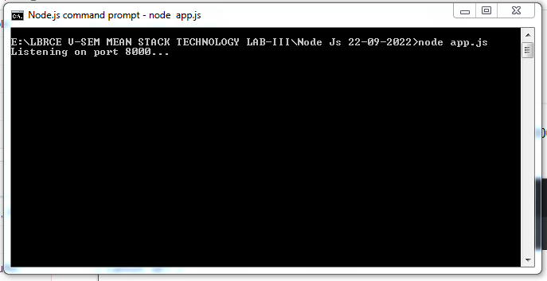
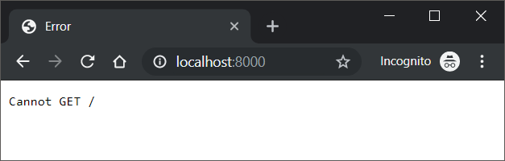
In the above Express application, we started the server, but did not define what has to happen when a request hits the server.

Slide 16
This is where Express.js Routes come into picture. Following is a simple express route.
app.get('/', function (req, res) {
res.send(' This is a Sample Example for Express.js ')
})
    var express = require('express')
    var app = express()
app.get('/', function (req, res) {
res.send(' This is a Sample Example for Express.js ')
})
    console.log('Listening on port 8000...');
    var server = app.listen(8000)

Slide 17
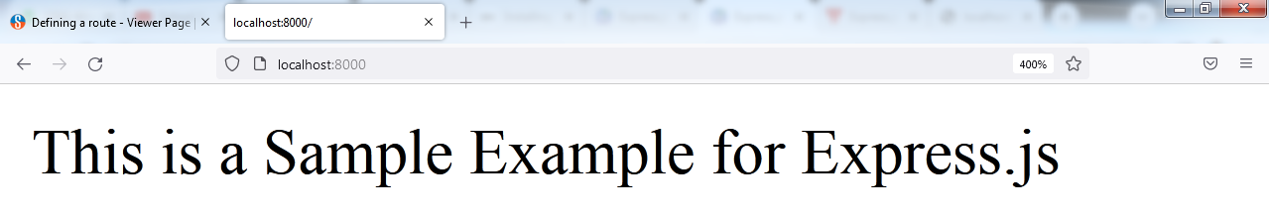
What does this route define? This route defines that, execute the statements inside the function, when you receive a GET request with request url as /.

Slide 18
In the following program is a route, where the function is executed for a GET request with request url /welcome/ (or) /hello/ (or) /bye/ (or) /thank you/
var express = require('express')
var app = express()
// route that gets executed for GET request and the request url path '/' or root
app.get('/', function (req, res) {
res.send('This is a Sample Example for Express.js .')
})
// route that gets executed for GET request and the request url path '/hello/'
app.get('/welcome/', function (req, res) {
res.send('Welcome to node express.js.')
})
// route that gets executed for GET request and the request url path '/bye/'
app.get('/hello/', function (req, res) {
res.send('hello page.')
})
// route that gets executed for GET request and the request url path '/bye/'
app.get('/bye/', function (req, res) {
res.send('bye page.')
})
// route that gets executed for GET request and the request url path '/bye/'
app.get('/thank/', function (req, res) {
res.send('Thank you page.')
})
// start the server
var server = app.listen(8000, function(){
console.log('Listening on port 8000...')
})

Slide 19
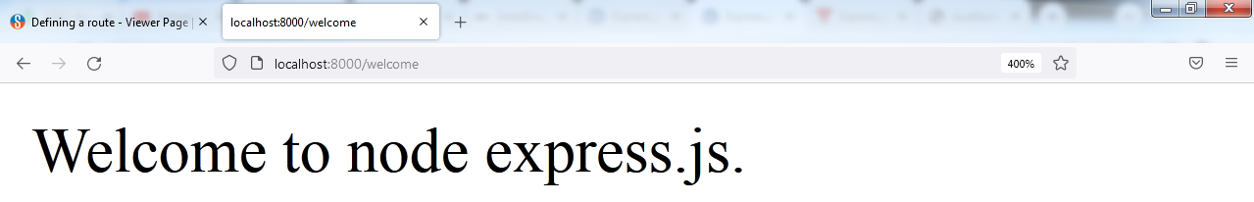
GET request with URL path http://localhost:8000/
GET request with URL path http://localhost:8000/welcome

Slide 20
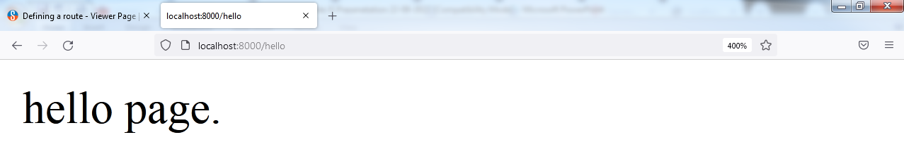
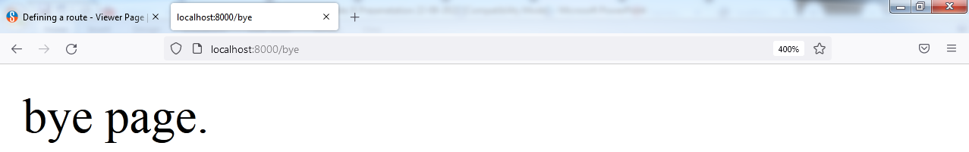
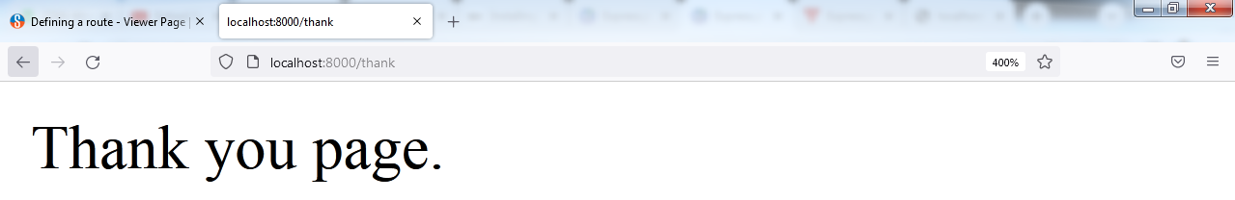
GET request with URL path http://localhost:8000/hello
GET request with URL path http://localhost:8000/bye
GET request with URL path http://localhost:8000/thank

Slide 21
EXPRESS.JS GET REQUEST
GET and POST both are two common HTTP requests used for building REST API's.
GET requests are used to send only limited amount of data because data is sent into header while POST requests are used to send large amount of data because data is sent in the body.
Express.js facilitates you to handle GET and POST requests using the instance of express.

Slide 22
index.html
<html>
<body>
<form action="http://127.0.0.1:8000/get_example" method="GET"> First Name: <input type="text" name="first_name"/> <br/>
Last Name: <input type="text" name="last_name"/><br/>
<input type="submit" value="Submit"/>
</form>
</body>
</html>

Slide 23
get_example.js
var express = require('express');
var app=express();
var fname="";
var lname="";
app.get('/get_example', function (req, res) {
fname=req.query['first_name'];
lname=req.query['last_name'];
res.send('<h1><p>Username: ' +fname +'</p><p>Lastname: '+lname+'</p></h1>');
})
console.log('Listening on port 8000...');
var server = app.listen(8000)

Slide 24
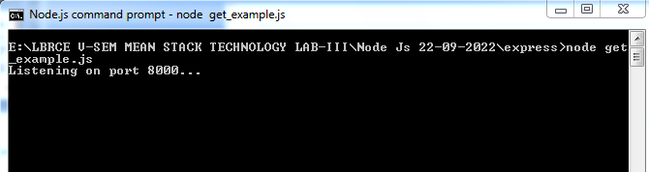
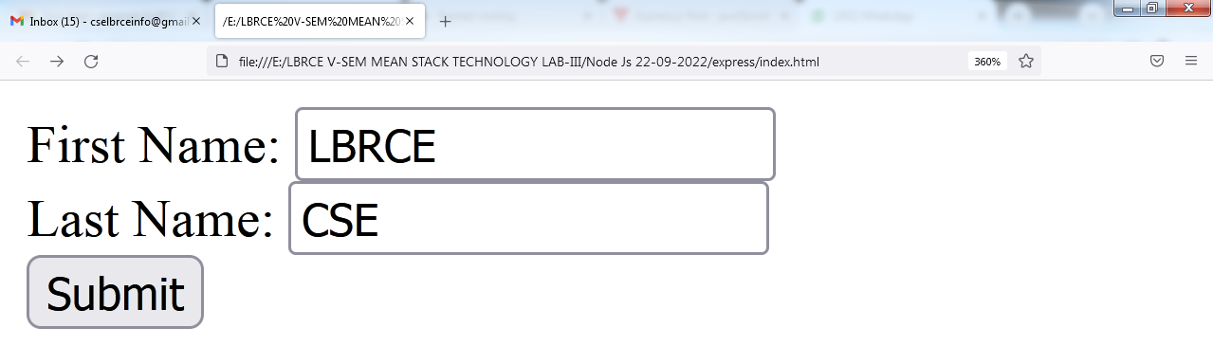
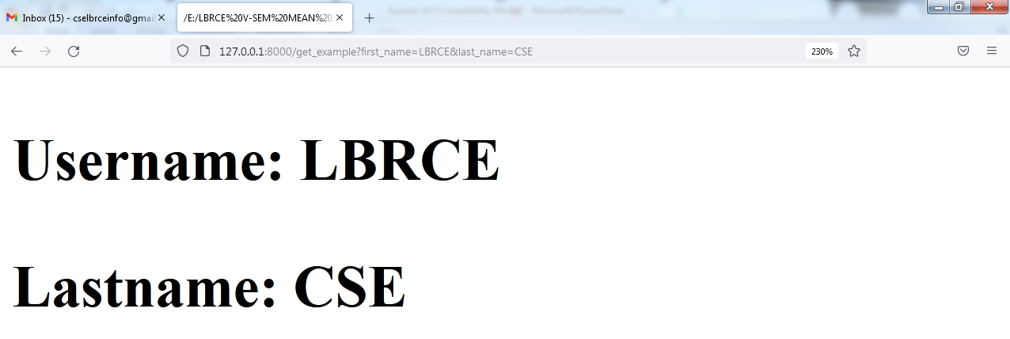

Slide 25
EXPRESS.JS POST REQUEST
GET and POST both are two common HTTP requests used for building REST API's.
POST requests are used to send large amount of data.
Express.js facilitates you to handle GET and POST requests using the instance of express.
Post method facilitates you to send large amount of data because data is send in the body.
Post method is secure because data is not visible in URL bar but it is not used as popularly as GET method.
On the other hand GET method is more efficient and used more than POST.

